Slide 1




NEXT GEN EMPLOYABILITY PROGRAM
Creating a future-ready workforce
Team Members
College Name
Student Name :Ashika K
Student ID :au960221104028
Arunachala College of Engineering for Women

Slide 2

CAPSTONE PROJECT SHOWCASE
Project Title
Car Rentals Application with Django Framework
Abstract | Problem Statement | Project Overview | Proposed Solution | Technology Used | Modelling & Results | Conclusion

Slide 3
Abstract
The car rentals application built on Django framework offers a streamlined platform for both customers and administrators to efficiently manage car rental services . Implement user registration , login , and logout functionalities using Django’s built-in authentication system. With user friendly interfaces , customers can browse , reserve , and manage bookings effortlessly , while administrators can oversee car and booking management seamlessly ,Key features include user authentication , such as payment integration , rigorous testing , and security measures further enhance the application’s reliability and usability . Leveraging Django’s robust framework , the application ensures scalability , security ,and optimal performance , providing a comprehensive solution for car rental businesses.
Source :

Slide 4
Problem Statement
Develop a web – based application for a car rental company that allows users to rent cars for various durations. The system should provide functionality for both customers and administrators . Describe the problem your application aim to solve . For example , inefficient car rental processes , lack of online booking options .
Source :

Slide 5
Project Overview
. User Authentication:
Secure login for customers and administrators.
. Car Inventory:
Manage car details and availability.
. Browsing:
User-friendly interface for browsing available cars.
. Reservations:
Allow customers to reserve cars for specific dates.
. Booking Management:
Admin interface to manage bookings efficiently.
. User Dashboard:
Personalized dashboards for users to manage activities.
Source :

Slide 6
Proposed Solution
1. User Authentication:
Implement user registration , login , and logout functionalities using Django’s built-in authentication system.
Ensure secure password storage and password reset functionality,
2. Booking System:
Design a booking system where users can select available cars for specific dates .
3. Search and Filter:
Implement search functionality to allow users to search for cars based on various criteria such as location etc.
Source :

Slide 7
  4. Car Management:
  Create models to represent car listings with attributes such as make , model , year , price , availability status , and images.
  Develop CRUD(Create , Read , Update , Delete)functionality to allow administrators to manage car listings through an admin panel.
  5. Payment Integration:
  Integrate a payment gateway to facilitate secure online transactions for booking fees
  Implement a checkout process with error handling and confirmation messages.
  6. Notifications:
  Set up email notifications to send booking confirmations , reminders , and update to users.
Source :

Slide 8
7. Responsive Design:
Develop a responsive user interface using HTML , CSS , and JavaScript frameworks like
Bootstrap to ensure the application is accessible on various devices.
8. Security Measures:
Implement measures such as HTTPS , CSRF protection , and input validation protect against
common security vulnerabilities.
9. Testing and Quality Assurance:
Write unit tests and integration tests to ensure the reliability and functionality of the application.
Perform user acceptance testing to gather feedback and identify areas for improvement.
10. Deployment and Scalability:
Deploy the application to a reliable hosting platform with scalability options to accommodate increasing user traffic.
Source :

Slide 9


Technology Used
Front-end
Back-end
Source :

Slide 10
Modelling & Results
Modelling
User Authentication: Utilize Django's authentication system for secure user
login.
Car Inventory: Implement database model for car details including
availability.
.
Reservation System: Develop schema to manage reservations , l
linking users with booked.
Results
Customer Interface: User-friendly browsing and reservation features.
Admin Interface: Efficient management of car inventory and
bookings.
Reservation Handling: Customers can view, modify, or cancel
bookings.
Source :

Slide 11
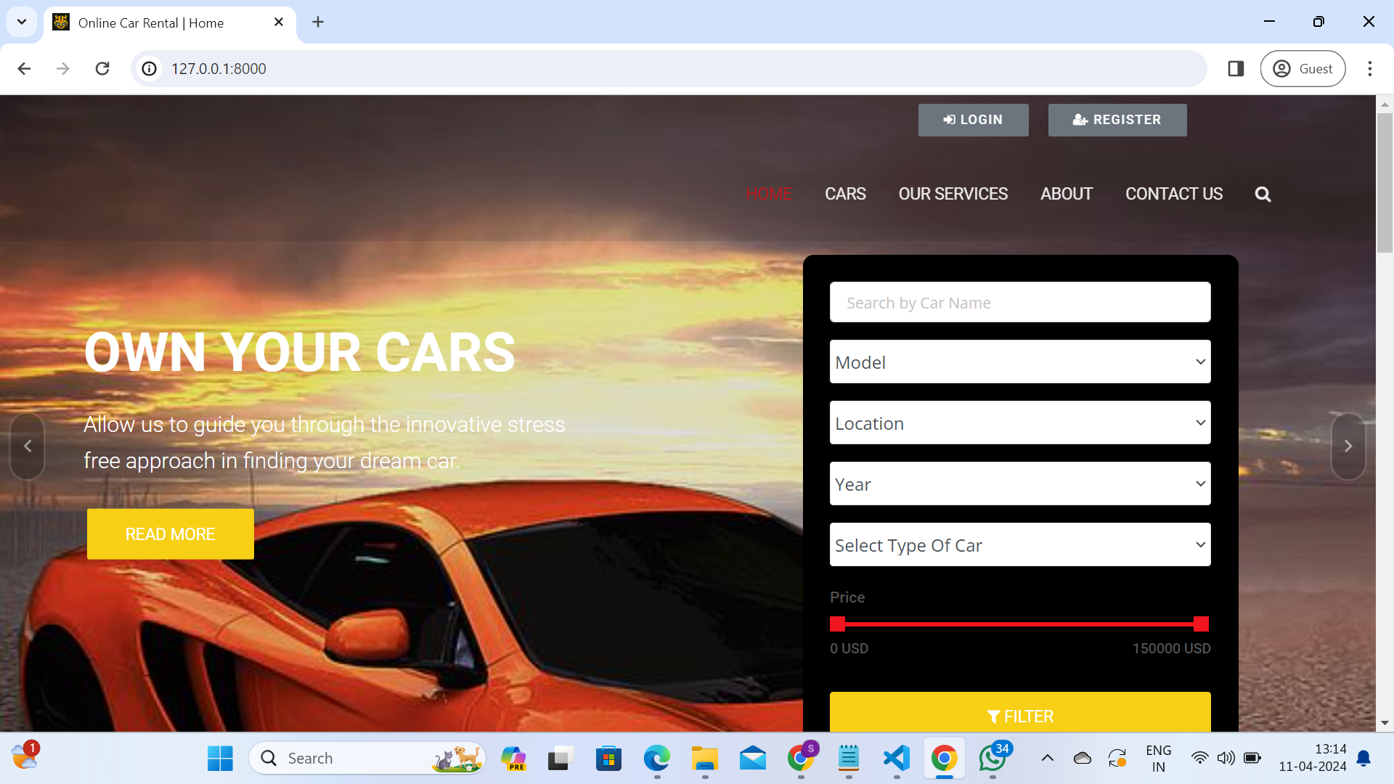
Homepage

Slide 12
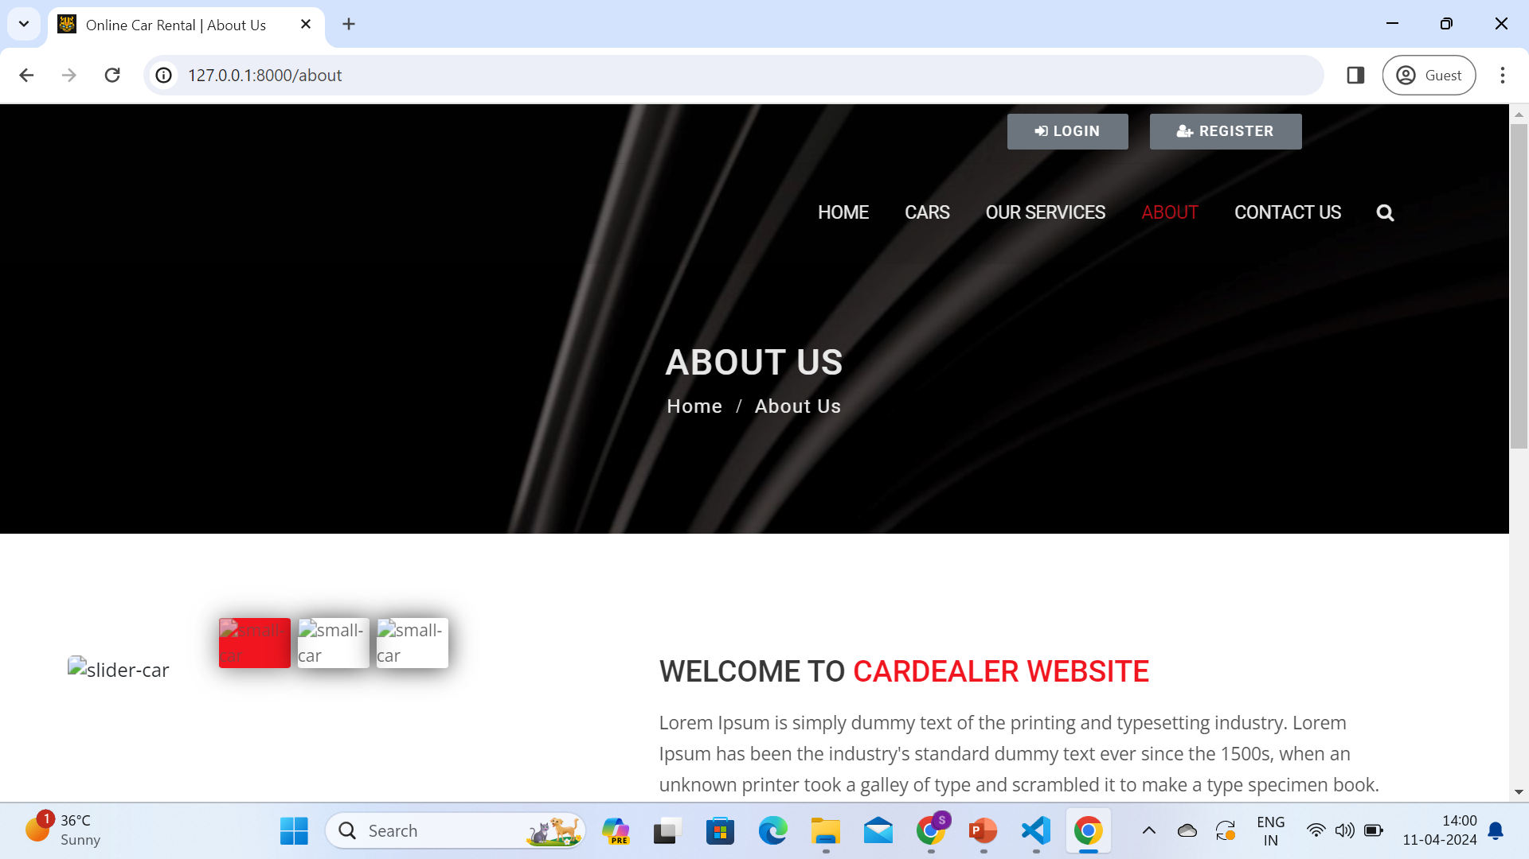

About-Us-Page

Slide 13
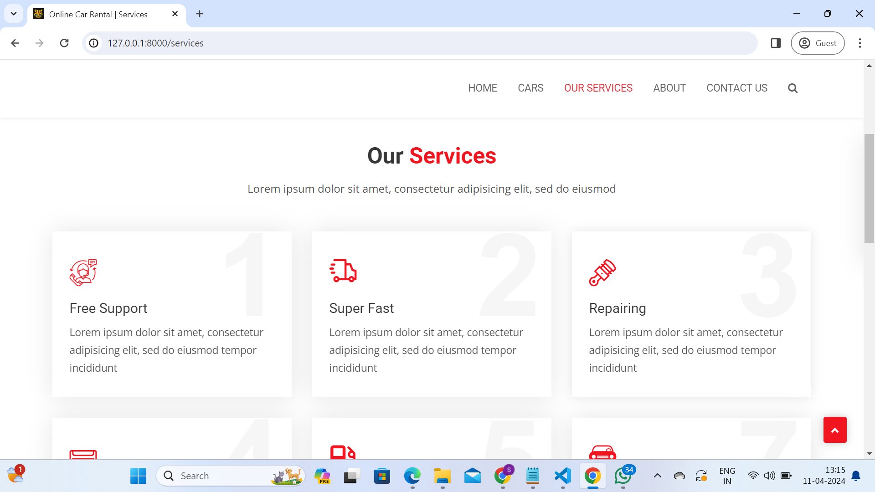
Service-Page

Slide 14
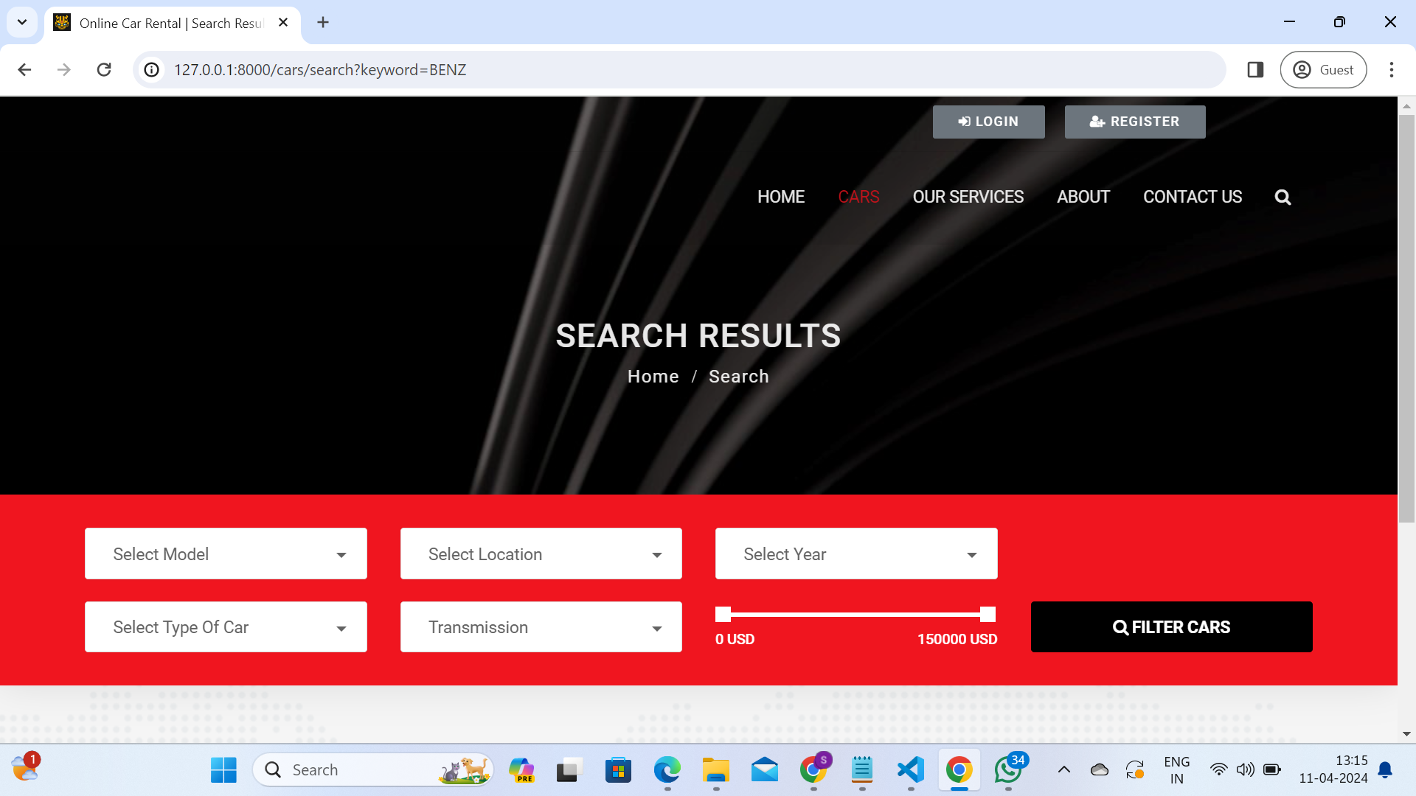
Blog-Page

Slide 15
Future Enhancements:
1.User Interface Refinement:
Implement responsive design to ensure the application is accessible and functional across various devices and screen sizes.
2.Advanced Search and Filtering:
Enhance the search functionality to allow users to filter cars based on additional criteria such as fuel efficiency, transmission type, features, etc.
3.Recommendation System:
Develop a recommendation system that suggests cars to users based on their past rentals, preferences, and browsing history.
4.Enhanced Booking and Reservation System:
Improve the booking and reservation system with features such as calendar availability, flexible pickup/drop-off times, and multi-car reservations for group trips.

Slide 16
Conclusion
In conclusion, building a car rental application with Django framework offers a robust and efficient solution for managing the rental process. Django provides a solid foundation for developing web applications, offering features such as built-in authentication, an ORM for database interaction, and a powerful templating engine.
Overall, leveraging Django framework for a car rental application enables you to deliver a professional and feature-rich platform that meets the demands of both customers and administrators alike. With its comprehensive set of tools and extensive documentation, Django empowers developers to create sophisticated web applications efficiently and effectively.
Source :

Slide 17
Thank You!
Notes:
Thank You !!

